Slide 1
Improving Insurance Penetration in Africa: Identify
Context: Africa represents 17% of the global population but contributes to only >1% of insured catastrophe losses. Insurance affordability and awareness are major challenges.
Industry Overview: Total value of premiums: $45 billion (2017). Average incomes are significantly lower than global counterparts.
Problem Statement
Objectives
Core Challenge: Low insurance penetration in Africa due to a lack of affordability, limited awareness, and inefficient underwriting practices
Key Questions:
How can underwriting processes be optimized to improve risk assessment and pricing?
How can affordable policies be designed for underserved income groups
How can targeted marketing improve customer engagement and policy uptake?
Identify and address inefficiencies in underwriting processes.
Develop data-driven insights for improving affordability.
Create a roadmap for increasing market awareness and trust.

Slide 2
Project Landscape
Aspect | Data | Information | Knowledge
Underwriting Process | What underwriting systems are used? | How do they assess risk and price policies? | What modern approaches or systems can enhance underwriting efficiency?
Market Segmentation | Socio-economic data of African regions. | Which regions and demographics have low/no insurance? | How can we design targeted marketing strategies for these demographics?
Affordability Analysis | Income levels and employment data. | What income brackets struggle with affordability? | What pricing models or micro-insurance options can improve uptake?
Customer Awareness | Current penetration rates and customer data. | Why do people opt out of insurance? | How can education and technology improve awareness and trust?

Slide 3
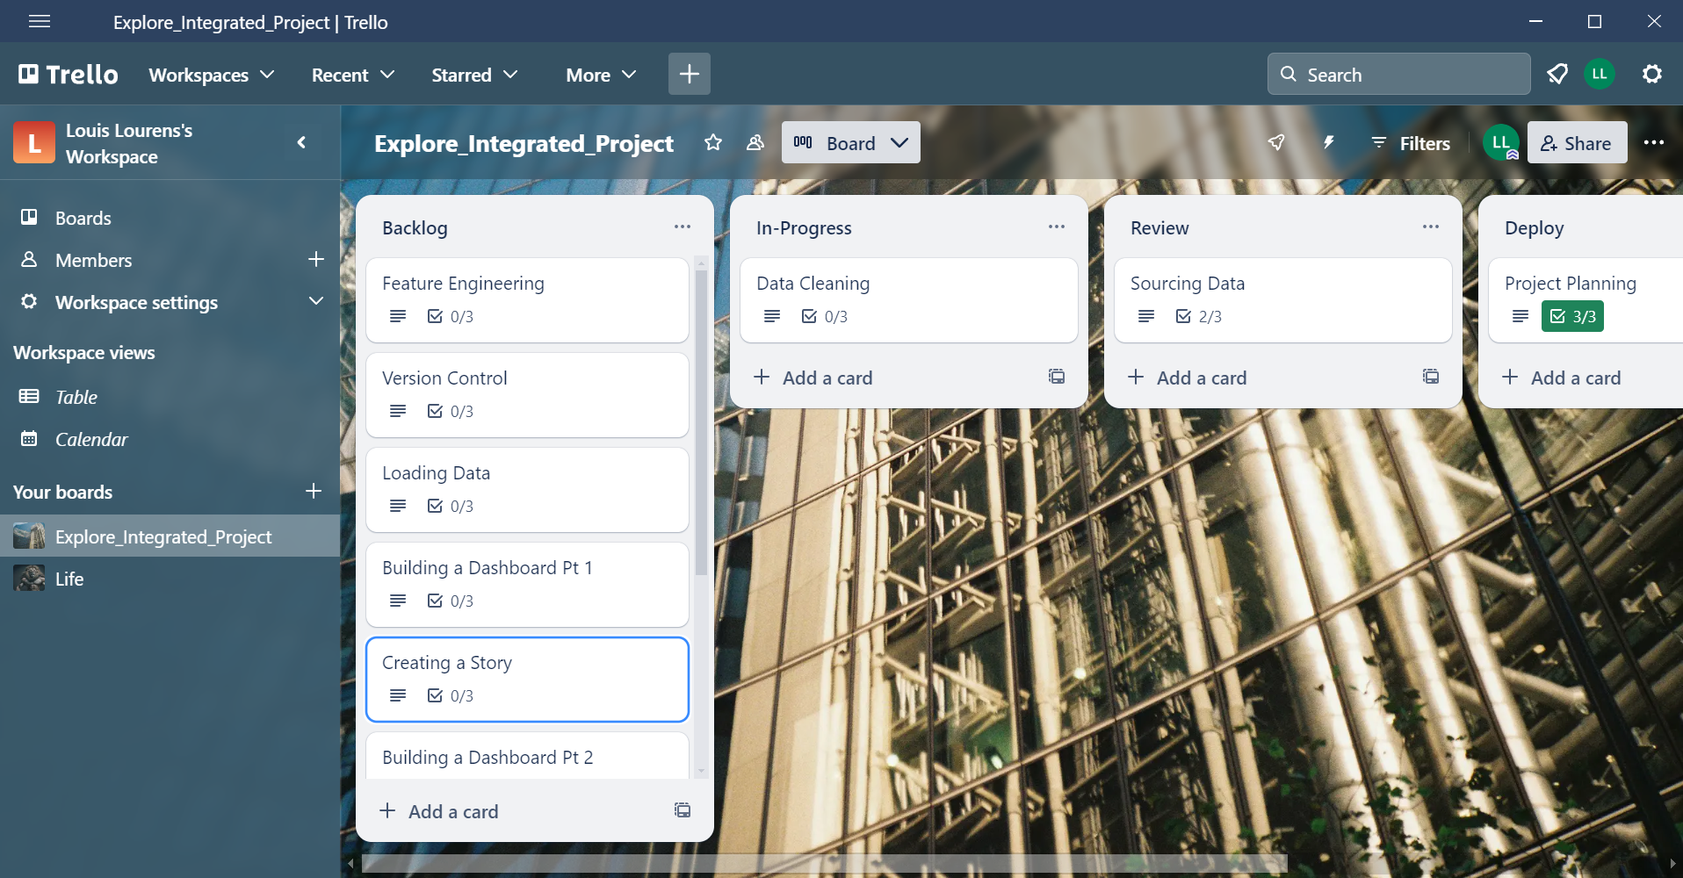
Workshop 4 – Project Planning

Slide 4
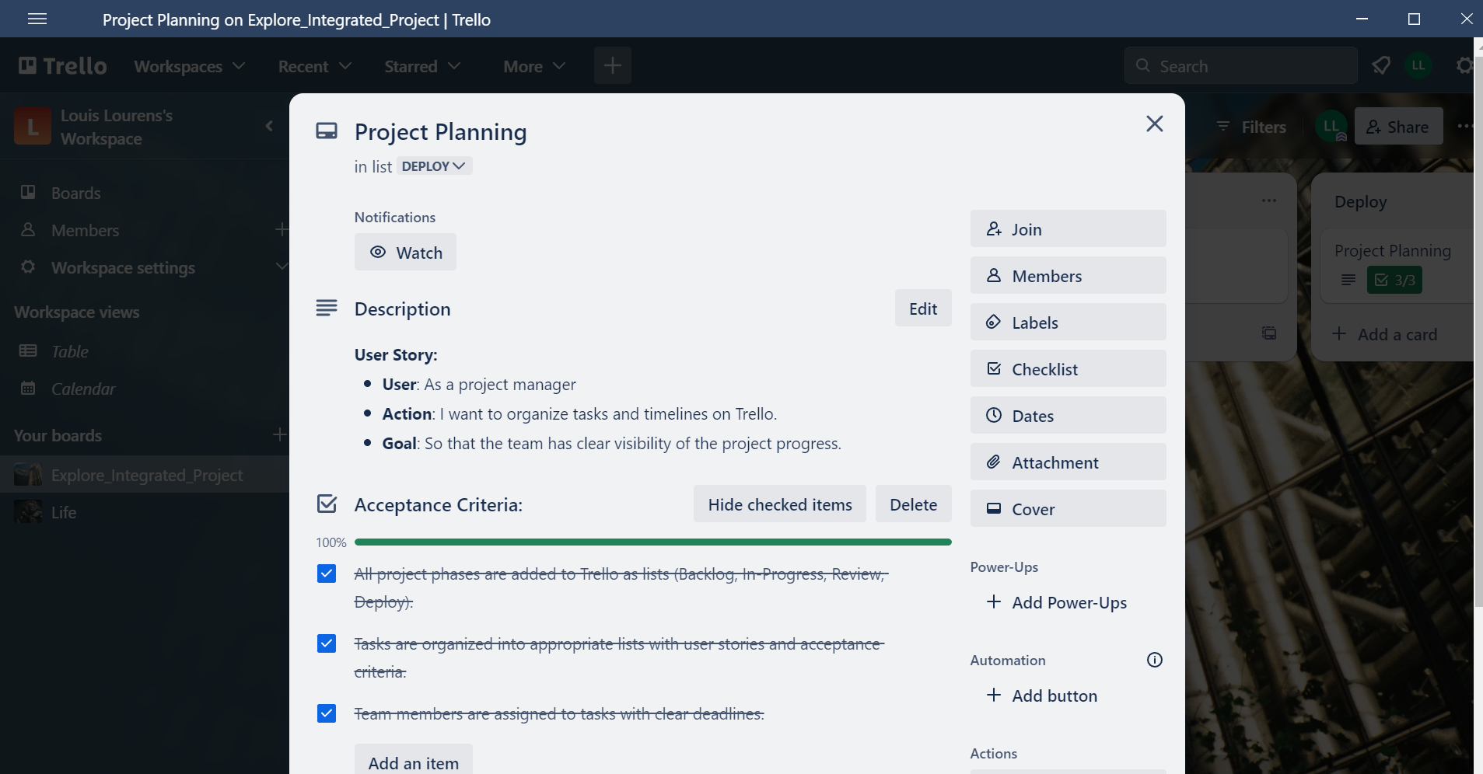
Workshop 4 – Project Planning

Slide 5
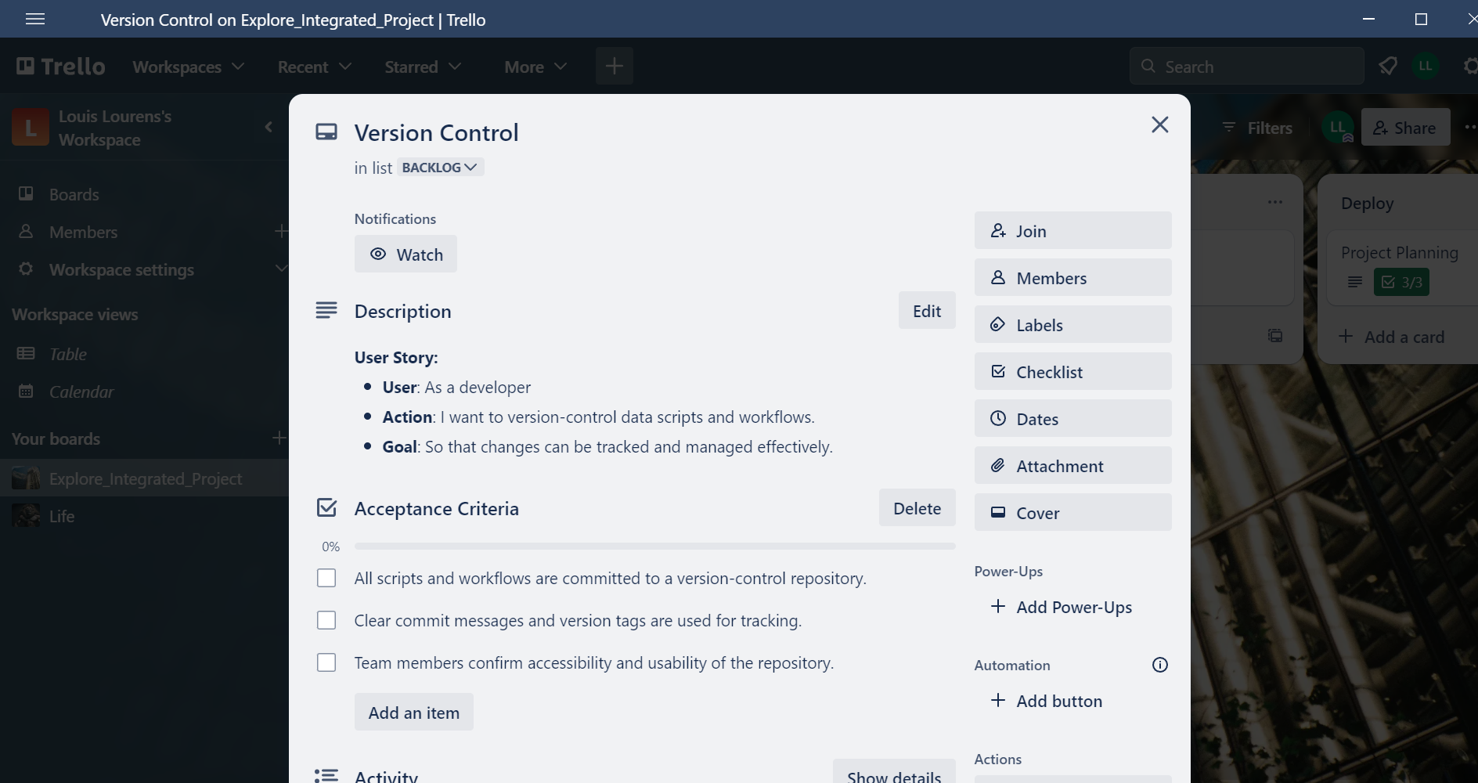
Workshop 4 – Project Planning

Slide 6
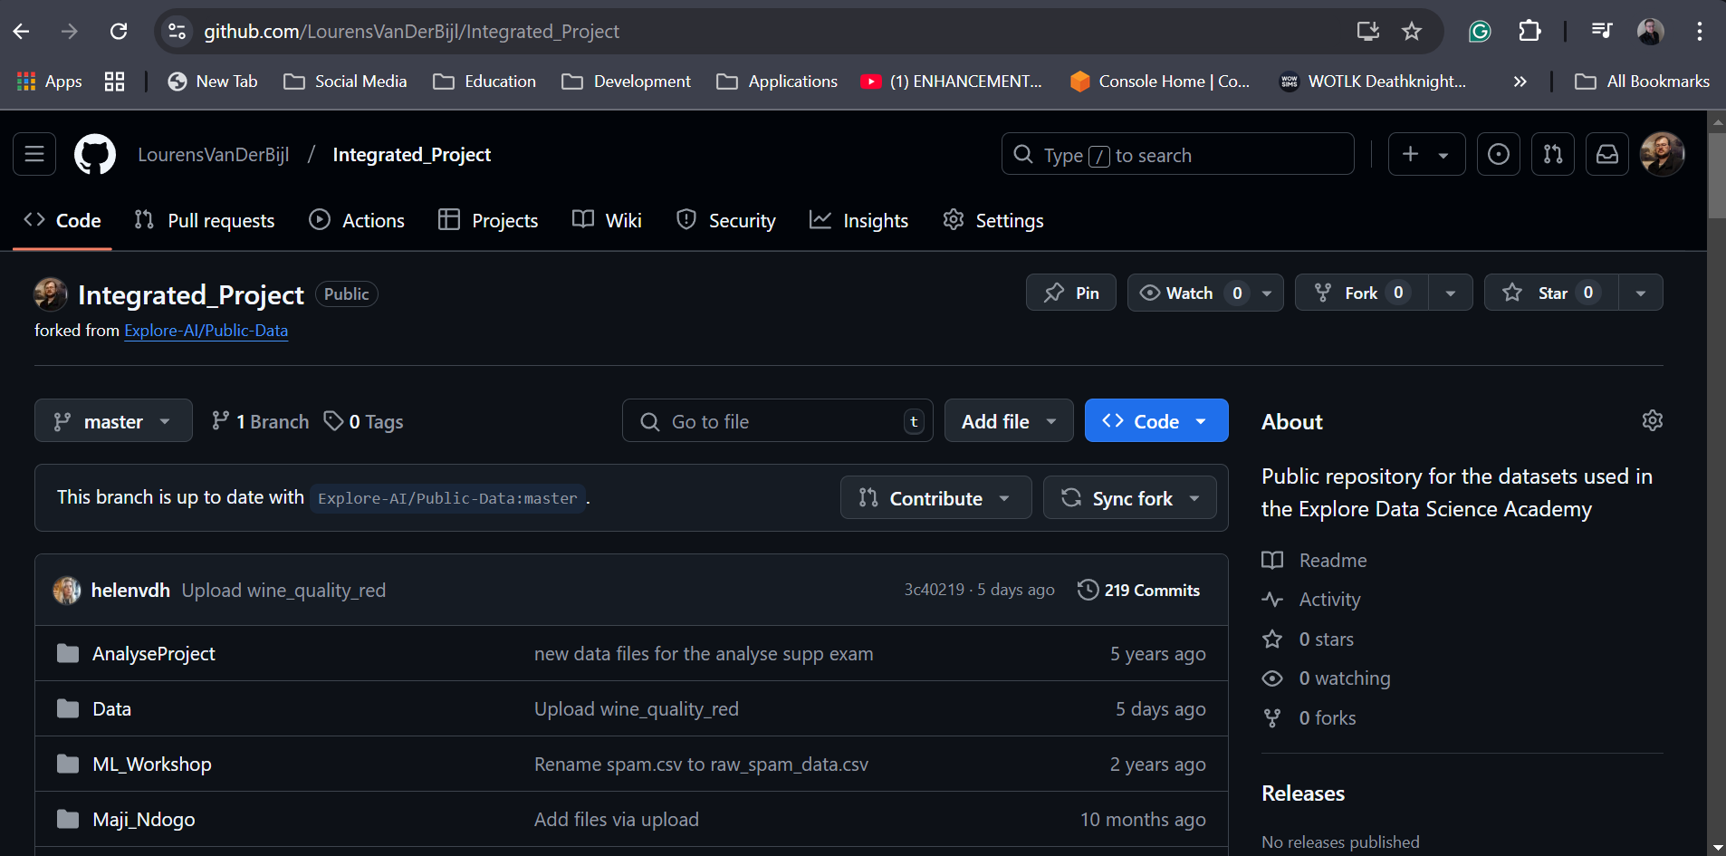
Workshop 5 – Sourcing Data

Slide 7
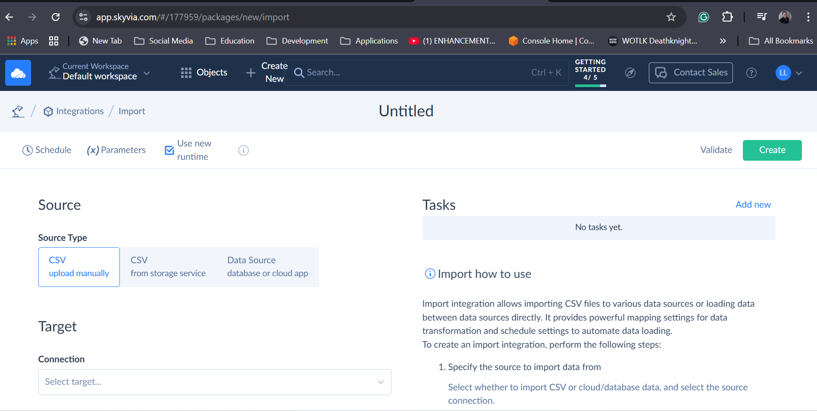
Workshop 5 – Sourcing Data

Slide 8
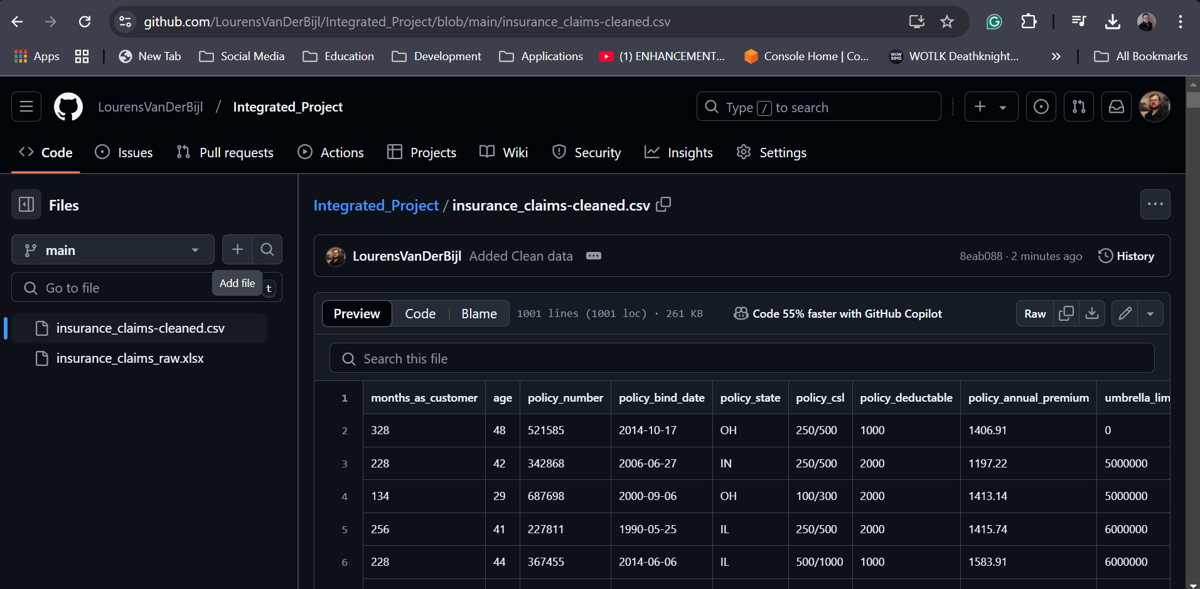
Workshop 6 – Cleaning Data

Slide 9
Workshop 7 – Feature Engineering
Detailed notebook can be found on the github repository. Please note that this notebook is connected to the data on github not my local machine
https://raw.githubusercontent.com/LourensVanDerBijl/Integrated_Project/refs/heads/main/Feature%20Engineering.ipynb

Slide 10
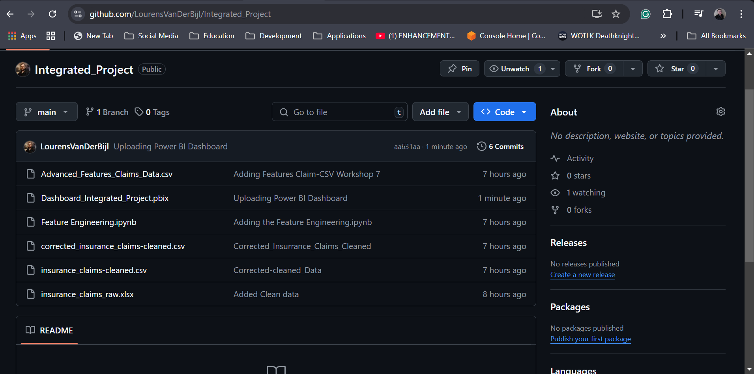
Workshop 8 – Version control

Slide 11
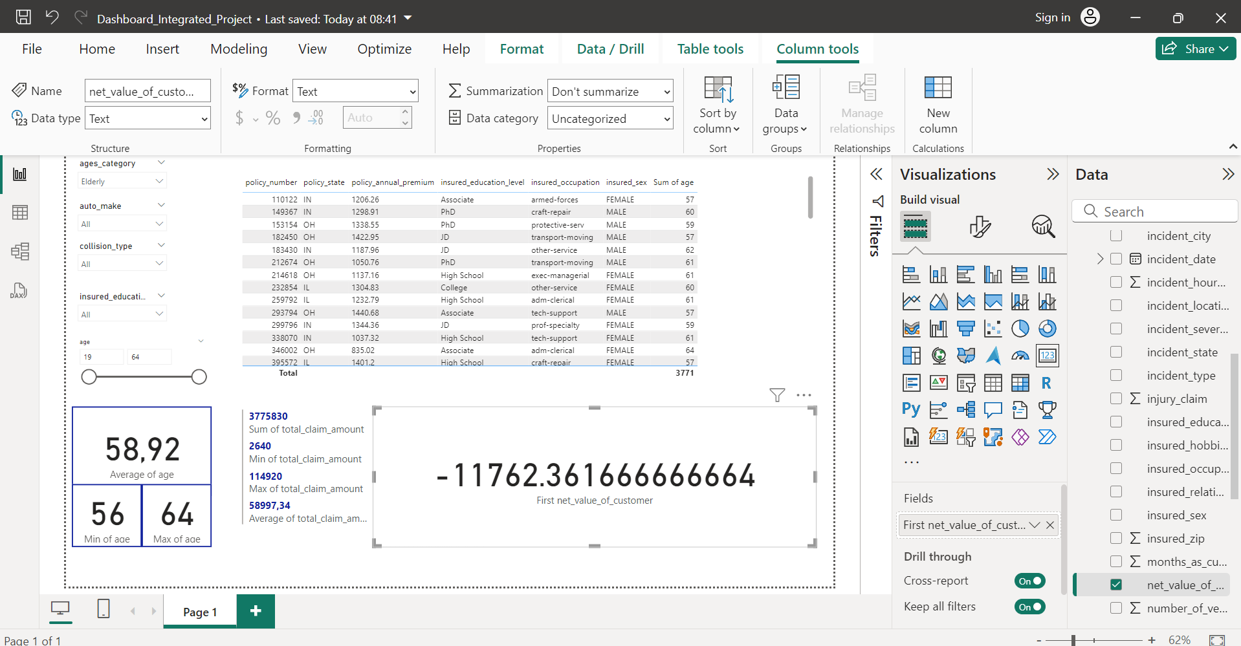
Workshop 9 _ Power BI

Slide 12
GitHub Repository
https://github.com/LourensVanDerBijl/Integrated_Project

